Slide 1
BIKE SHARING DEMAND - Time series analysis
TEAM-5

Slide 2

Team-5
Niranjan Reddy Masapeta
Purna Sai Mahesh Goud Palagani
Sujan Rao Chikkela
Utsav Savaliya

Slide 3

Abstract
Time series analysis is one of the most popular data analysis methods from long time. In this project, we focus on bike sharing demand forecasting problem which is an application of time series modelling.

Slide 4

Introduction and Problem Statement
Time series forecasting in statistics is a method where we predict variables that change over time.
In our problem, we have a time-series data related to bike rental service where customers rent a bike for the day and we need to forecast the demand i.e. the number of customers who will rent the bike depending on the conditions around him.
Our goal of the project is to forecast the number of customers expected to rent bikes given the previous data.
Our goal includes applying different data analysis and visualisation techniques taught in this course to gain insights from the data.

Slide 5
Data Analysis
Before jumping into the data modelling, we have to perform Exploratory Data Analysis (EDA) on the dataset to gain insights from the data.
Data Analysis and Data Visualization are part of EDA methods.
EDA is one of the most important steps in Machine Learning as the accuracy and efficiency of a Machine Learning model depends on the data the you feed to the model.
EDA is also important because of the insights you gain from the data can be very helpful for the growth of certain businesses, in our case being Bike rental sharing business.

Slide 6
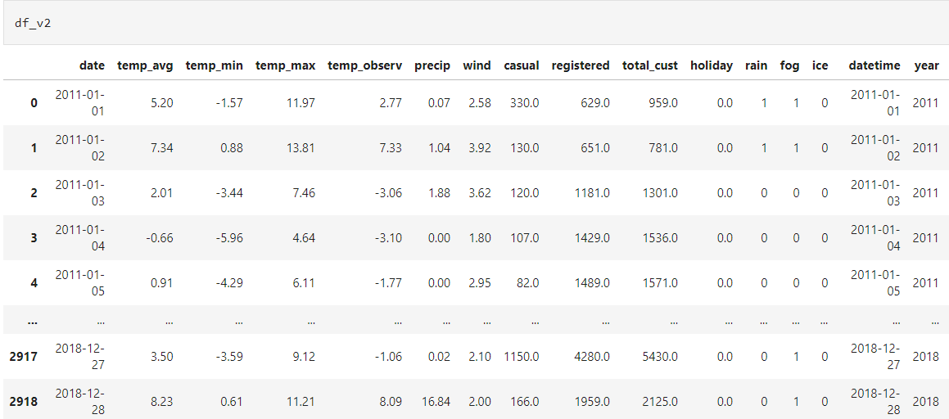
Dataset Overview

Slide 7
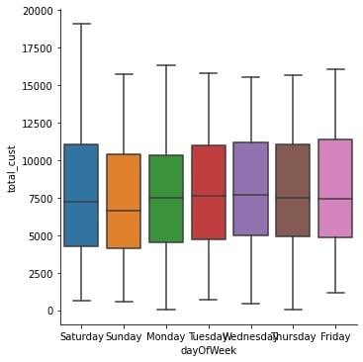
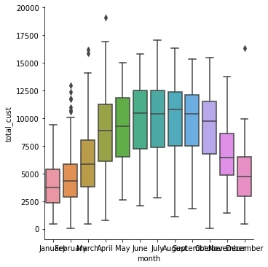
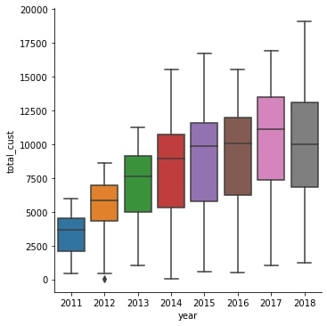
Data Analysis - Insights

Slide 8
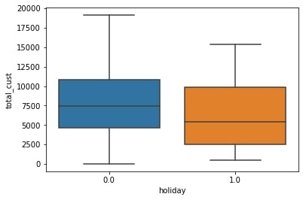
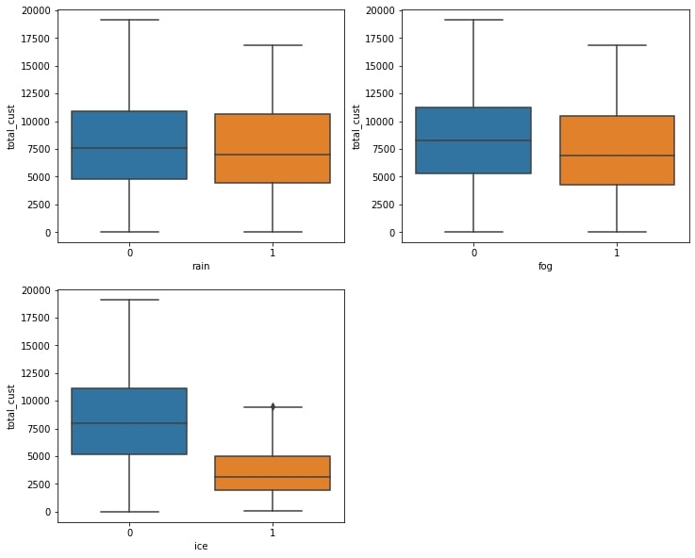
Data Analysis - Insights

Slide 9
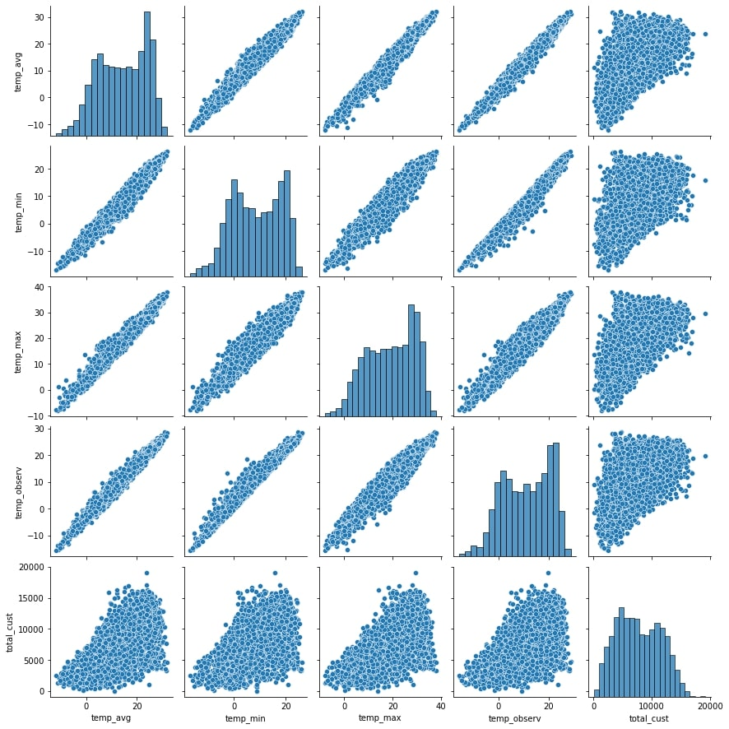
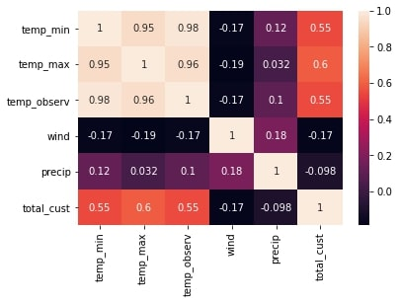
Data Analysis - Insights

Slide 10
Data Modelling…..
Before going to data modelling, our data is a time series data.
We need to check for stationarity

Slide 11
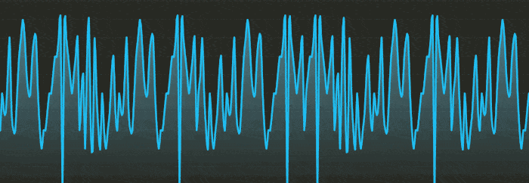
Time series analysis - Stationarity vs Non-stationarity
A stationary time series is a series whose properties such as mean, variance and autocorrelation doesn’t change over time. If the properties change over time, then it is non-stationary series.
We should ensure that the series is stationary in order to forecast correctly and if the series is non-stationary, we convert it to stationary.
Stationarity is preferred because if the mean and variance increase over time, it is difficult to forecast as the series is changing over time.
Augmented Dickey Fuller (ADF) test and Kwiatkowski–Phillips–Schmidt–Shin (KPSS) test are used to evaluate if a series is stationary or non-stationary.

Slide 12
Time series analysis - Stationarity vs Non-stationarity
ADF test has hypothesis testing for difference stationarity whereas KPSS test looks for trend stationarity in the series.
Non-stationary series is converted to stationary series using following methods,
Differencing: Removes series dependencies on time
Detrending: Removes trend effects from the dataset
Transformation: Converts into stationary using log transfer method
After converting the dataset to stationary series, next step is data modelling.

Slide 13
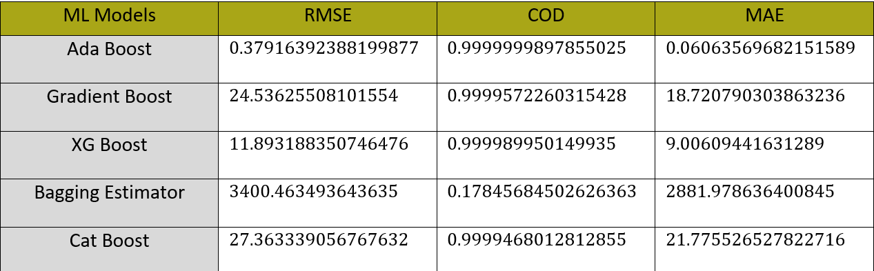
Data Modeling and Results

Slide 14
THANK YOU!
Any Questions?

